Slide 2
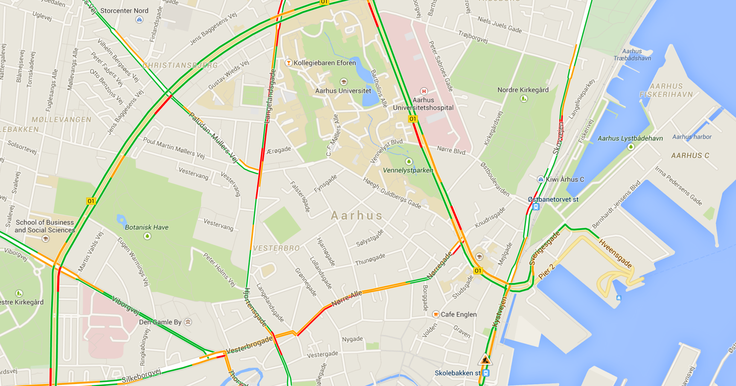
IIIIIIII
III

Slide 3

IIIIIIII
Server is full!
Hvad er det I fylder jeres servere med?
III

Slide 4
MAIN MENU
IIIIIIII
III

Slide 5

MAPS
Road map (traffic)
IIIIIIII
Road map
Topographic
Population map
Infrastructure
III

